Slide 1
A Study Of The Book Of Revelation
August 15, 2021

Slide 2
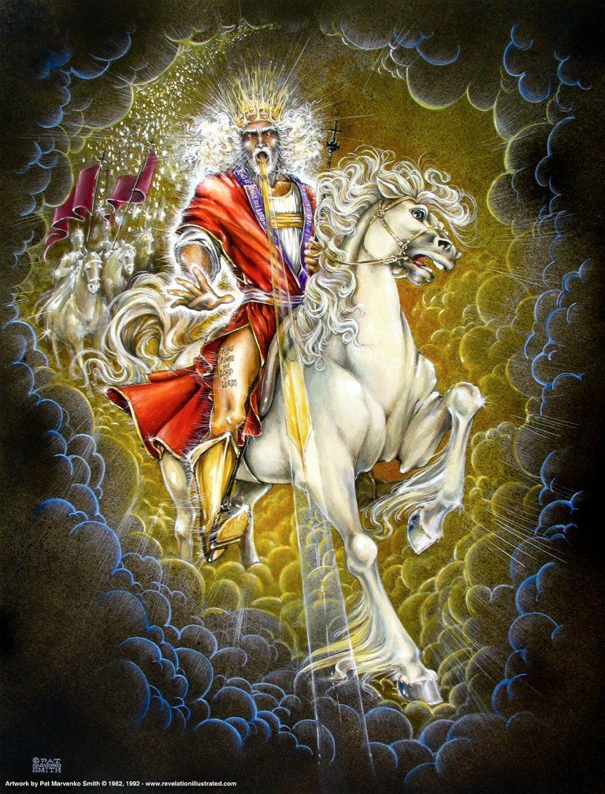
Christ The Victorious Rider Upon A White Horse (Revelation 19:11ff)

Slide 3

Revelation 19:11
Revelation 19
“And I saw the heaven opened; and behold, a white horse, and he that sat thereon called Faithful and True; and in righteousness he doth judge and make war.”

Slide 4
Revelation 19:12
Revelation 19
“And his eyes (are) a flame of fire, and upon his head (are) many diadems; and he hath a name written which no one knoweth but he himself.”

Slide 5
Revelation 19:13
Revelation 19
“And he (is) arrayed in a garment sprinkled with blood: and his name is called The Word of God.”

Slide 6
Rider on White Horse
Revelation 19
Victorious Christ
Leader on a white (Victory)
Horse – the symbol of war or battle (Job 39:19-25; Zechariah 10:3) speed (Jeremiah 4:13) and victory Revelation 6:2
Identified – Faithful and True (Revelation 1:5 and 3:14). This is the Christ!
In righteousness, He judges and makes war
He is the leader of a spiritual army
Eyes like a flame of fire (1:14). This is the Christ!
Wearing many diadems – crowns of royalty – widespread dominion. See: 6:2;
Third time we see “diadems.” cf. 12:3; 13:1 and 19:12

Slide 7
Rider on White Horse
Revelation 19
Name which no one knows. Only God knows the full significance of the Savior’s name. (2:17)
One’s name indicates all that he is!
All I know is what is revealed.
Clothed with robe sprinkled in blood. (Isaiah 63:1-6)
Blood He shed on cross, or the blood from the winepress of His wrath? cf. Joel 3; Revelation 16
He comes to conquer. Revelation 6:16; Romans 11:22
Rules with a rod of iron. (cf. Psalms 2:9-12 and Isaiah 11:4).

Slide 8
Rider on White Horse
Revelation 19
The rider is known by three names, leaving no doubt but that Jesus Christ heads up the heavenly army.
He is the Faithful and True (1:5; 3:7, 14),
He is the Word of God (verse 13; John 1:1-3, 14), and
He is King of kings, and Lord of lords (verse 16; 17:14).
He is supreme over all. cf. Deuteronomy 10:17; Daniel 2:47; 1 Timothy 6:15

Slide 9
Rider on White Horse
Revelation 19
Blood He shed guarantees the defeat of Satan and plans to defeat Him
Christians don’t defeat Satan by their own power
Only one power strong enough to conquer sin and the devil
Faith and hope must be focused on this fact!
This is where triumph originates!

Slide 10
Rider on White Horse
Revelation 19
In an earlier vision, portrayed the army of Satan as led by three devilish spirits looking like frogs (16:12-16)
On his side too the political power of the beast, the pagan religion of the false prophet and those with the mark of the beast.
People of the world, generals, the rich and poor, educated and uneducated – opposing God.

Slide 11
Revelation 19:14
Revelation 19
“And the armies which are in heaven followed him upon white horses, clothed in fine linen, white (and) pure.”

Slide 12
Revelation 19:15
Revelation 19
“And out of his mouth proceedeth a sharp sword, that with it he should smite the nations: and he shall rule them with a rod of iron: and he treadeth the winepress of the fierceness of the wrath of God, the Almighty.”

Slide 13
Revelation 19:16
Revelation 19
“And he hath on his garment and on his thigh a name written, KING OF KINGS, AND LORD OF LORDS.”

Slide 14
Armies of Heaven
Revelation 19
Army wearing white robes – also following on white horses (Spiritual army)
Fine linen – white and clean (purity and righteousness)
Sharp sword goes out of His mouth (1:16; 2:12; Hebrews 4:12) will strike the nations
Leader in conquest and power!
He rules with rod of iron (Ephesians 1:22-23)
He Himself treads the winepress of the fierceness and wrath of Almighty God! (14:19-20; Isaiah 63:1-7)

Slide 15
Armies of Heaven
Revelation 19
The victory Christ has won and gives to His people proves He alone has the right to rule over mankind!
KING OF KING, LORD OF LORDS! (17:14)
He leads the “called, chosen, and faithful.”
Blood stained vesture has writings across it
Any doubt who is leading this charge against the dragon, the beast, and the false prophet?

Slide 17
Revelation 19:17
Revelation 19
“And I saw an angel standing in the sun; and he cried with a loud voice, saying to all the birds that fly in mid heaven, Come (and) be gathered together unto the great supper of God;”

Slide 18
Revelation 19:18
Revelation 19
“that ye may eat the flesh of kings, and the flesh of captains, and the flesh of mighty men, and the flesh of horses and of them that sit thereon, and the flesh of all men, both free and bond, and small and great.”

Slide 19
God’s Great Supper
Revelation 19
In anticipation of the destruction of the dragon, beast, and false prophet – along with all who follow them
By the advancing Christ and His host
Angels comes in to call the vultures that fly across the sky to come feed on the corpses of the defeated enemies of Christ and His church.
Highly figurative and symbolic – but a vivid picture nevertheless!

Slide 20
God’s Great Supper
Revelation 19
Note: The Great Supper of God (Defeat) in contrast the marriage feast of the Lamb (Victory)!
Outcome of the true Battle of Armageddon (16:16; Ezekiel 38- 39:17-20) where Satan’s forces are gathered
Enemies of God’s people.
Tables have been turned in history!
Severity of God’s judgment that pits the Creature above the Creator (Romans 1:25)

